Slide 1
Skipjack Wind September 2022

Slide 2
Skipjack Wind
966 MW offshore wind farm.
Will generate enough clean, renewable energy to power 300,000 homes in the region.
Scheduled to deliver power to the grid in 2026.

Slide 3
BOEM Offshore Wind Leasing and Project Review

Slide 4
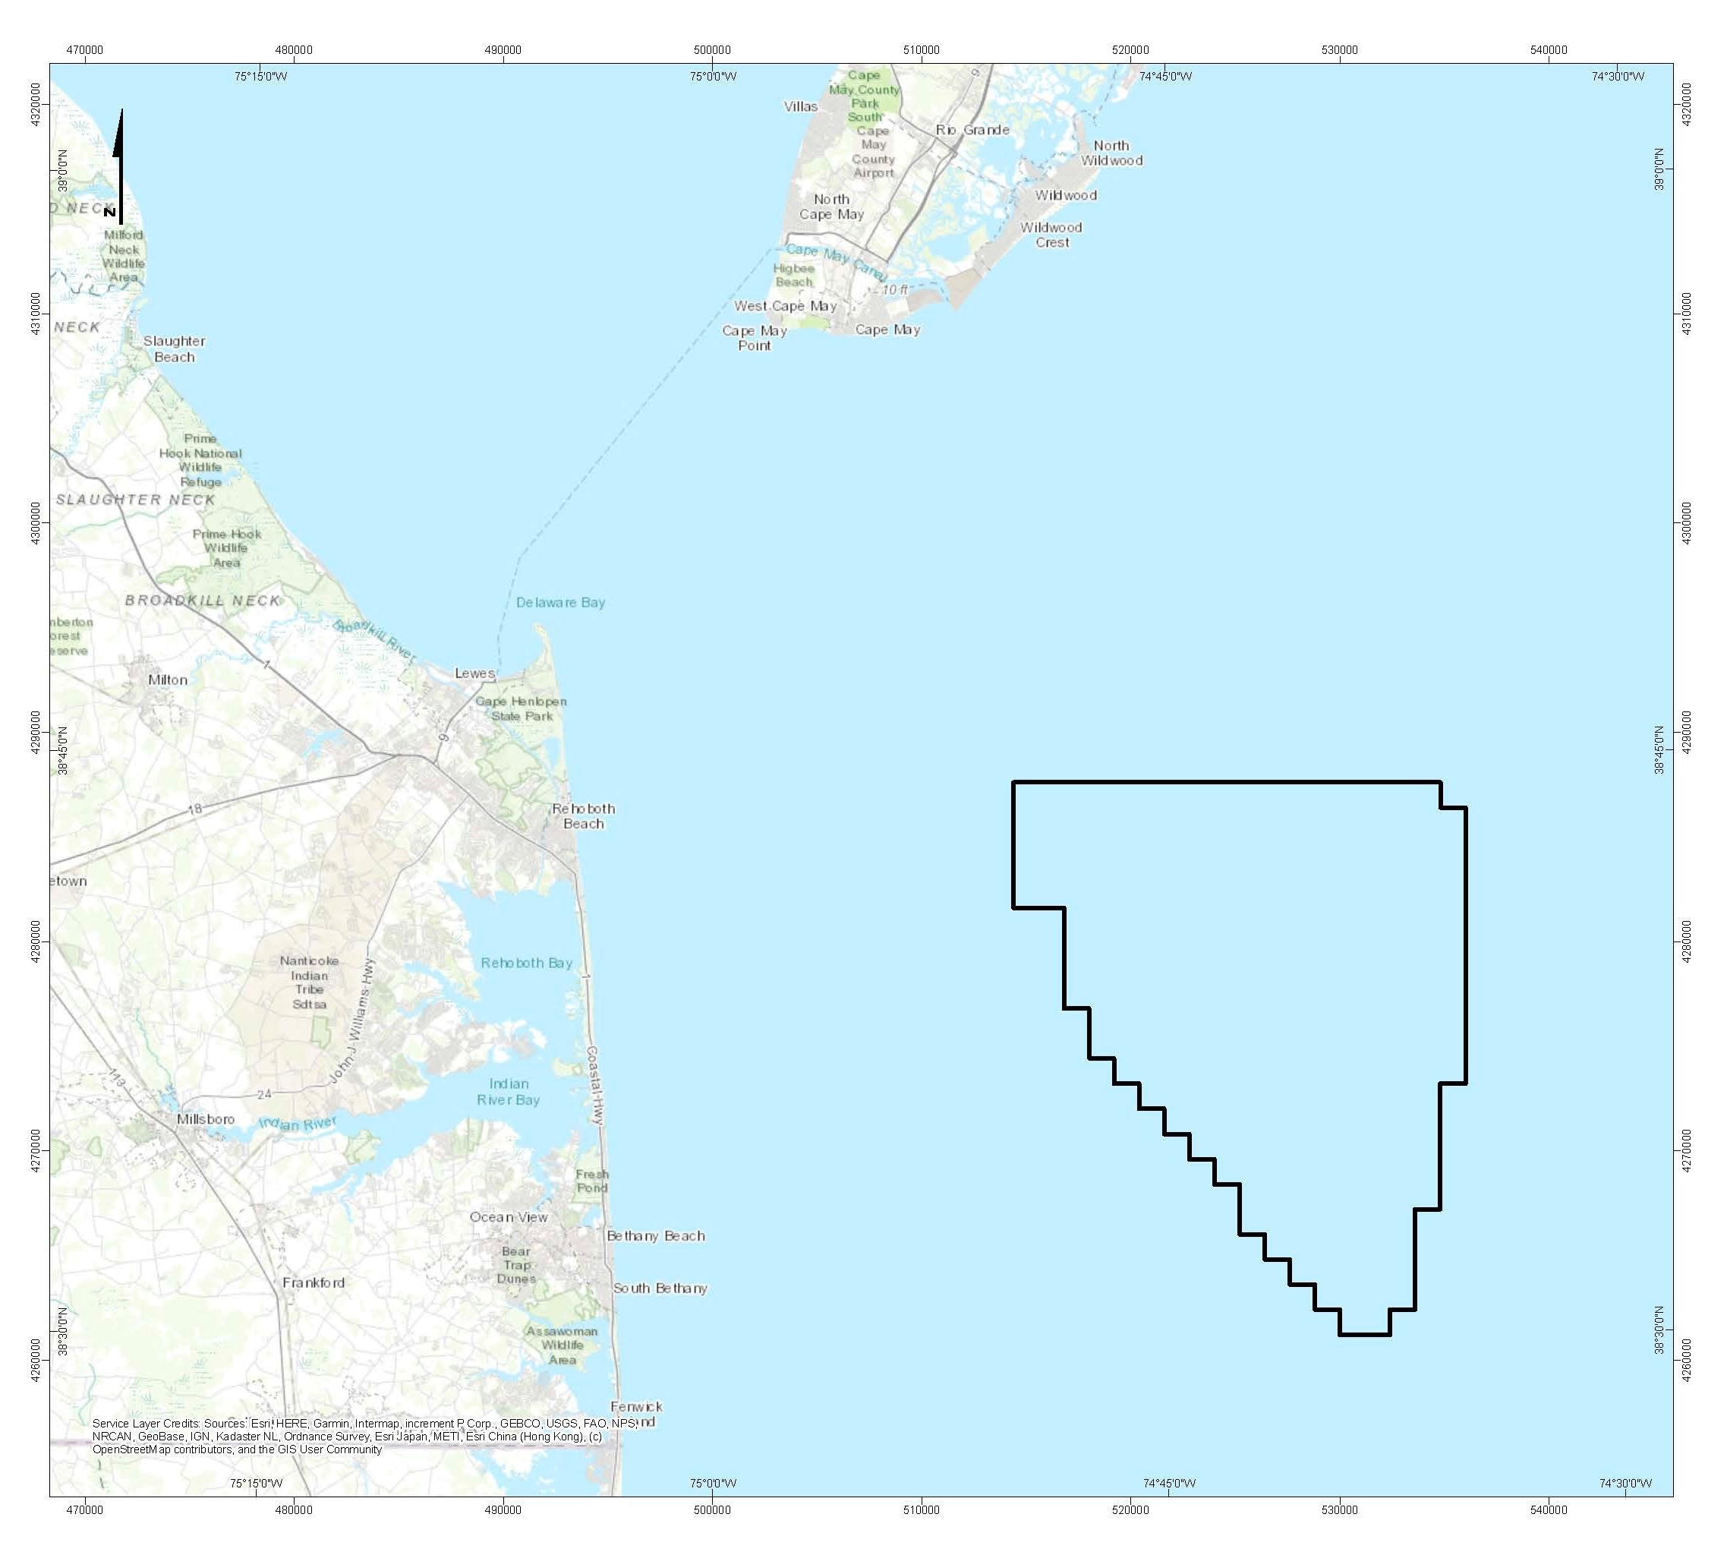

Slide 5
Current Status—Skipjack Wind

Slide 6
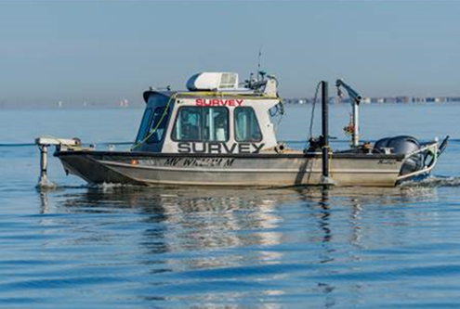
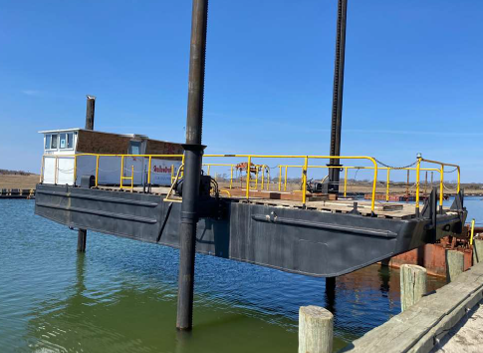
Survey Operations—Spring 2022

Slide 7
Project Review A public process involving federal, state, and local authorities and interests

Slide 8
Skipjack Wind & Delaware
Construction and operation of Skipjack’s onshore infrastructure—including its grid interconnection facility—will bring significant investment to the Delaware electric grid, create jobs for Delawareans, and opportunities for Delaware businesses.
Skipjack Wind will generate enough renewable energy to power nearly 300,000 homes in the Delmarva region and will bring improvements to the existing electric grid infrastructure.
Once construction is complete, the wind farm will be open for recreational and commercial fishing as well as other marine activities.
Ørsted is committed to investing in environmental research, restoration, preservation, education, and advocacy efforts.

Slide 9
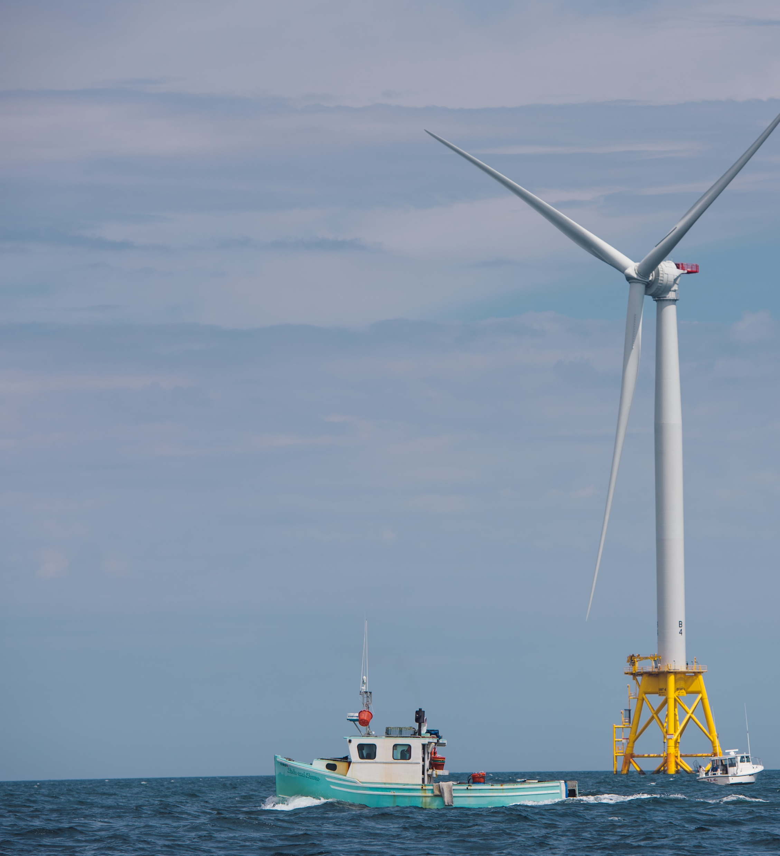
Mariner outreach philosophy
Promote the smart growth of the American offshore wind industry
Focus on maintaining access and navigation in and around our wind farms for all ocean users
Complete scientific research collaboratively with the fishing community
Be accessible and available
.

Slide 10
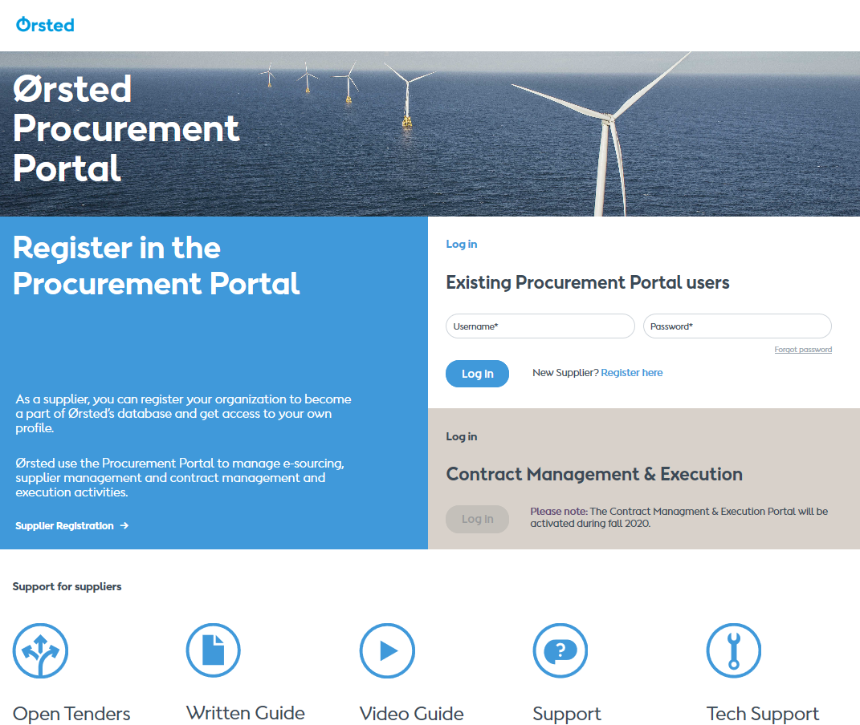
Register in the new Ørsted Procurement Portal
Please register your company and contact details at www.orstedprocurement.com.
Registration does NOT mean suppliers are approved/qualified to participate in tenders.
Upon registration, suppliers will become visible for sourcing managers via the database.
Supplier support found at the bottom of the front page →

Slide 11
Offshore wind market on the East Coast ~35 GW of state targets with +17 GW procured
Current/proposed OSW target (MW)
State procured (MW)
RI
MD
CT
NC
VA
MA
NJ
NY
*OCW01 is a 75/25 JV with PSEG

Slide 12
Our projects impact 40 states across the U.S.*
Over 500 employees working across the country
Stimulating nearly $2 billion into the American economy through supply chain and infrastructure investments
In operation
Under construction
Under development
Ørsted impact
*direct and indirect vendors

Slide 13
Brady Walker
857-408-4927
brwal@orsted.com

