Slide 1
Addressing Affordable Housing in the Rehoboth Area February 15, 2023
Sean O’Neill, AICP
Policy Scientist, Institute for Public Administration
oneill@udel.edu
(302)-831-4926
Notes:
Good morning – welcome to our webinar; we will get started in a few moments – Sean
Sean introduce Jerome and Steve and Kevin Gilmore

Slide 2
The Problem
Delaware is over 18,000 rental units short of where we should be to keep up with market demands (National Low Income Housing Coalition)
Cost is primarily impacting people under 40 and low and moderate income
Extremely negative impact on both the local economy and quality of life

Slide 3
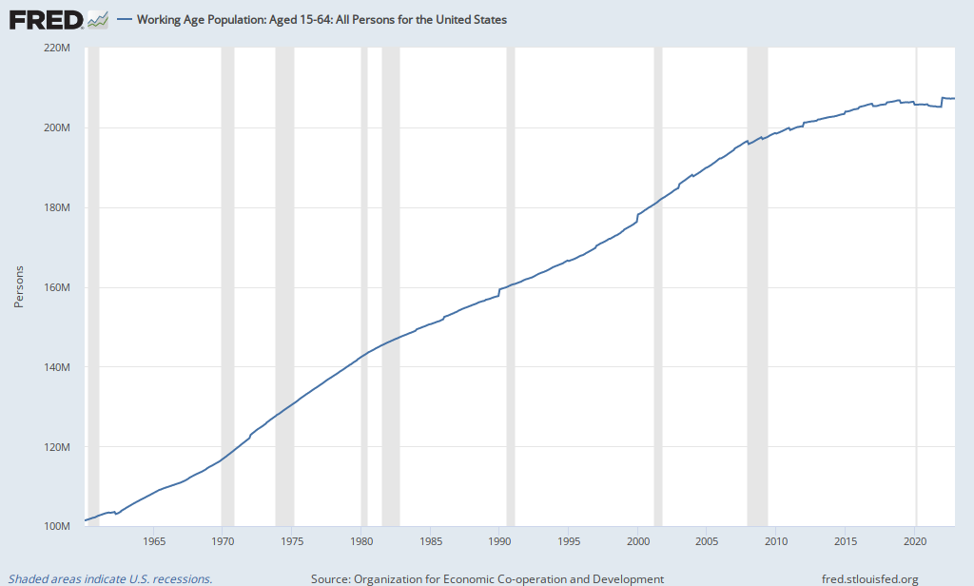
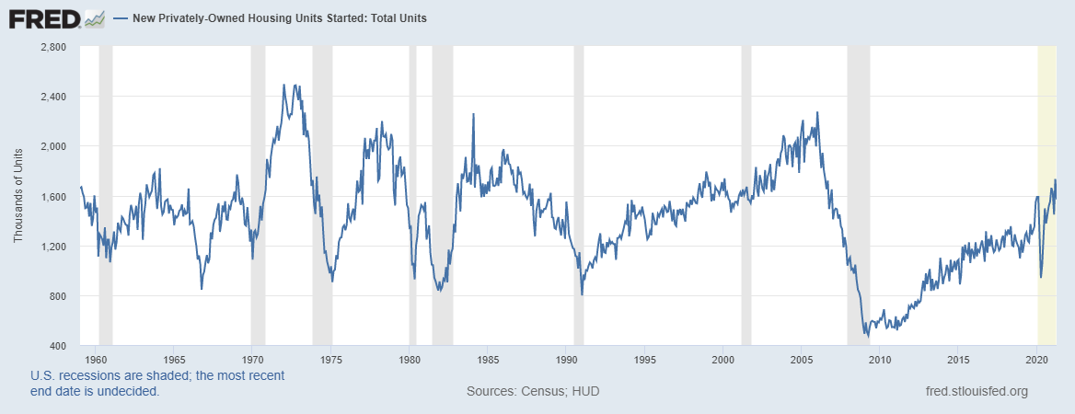
Housing Starts vs Population
1980
Working Age Population – 206 million
Housing Starts – 1.3 million
2019
Working Age Population – 129 million
Housing Starts – 1.3 million

Slide 4
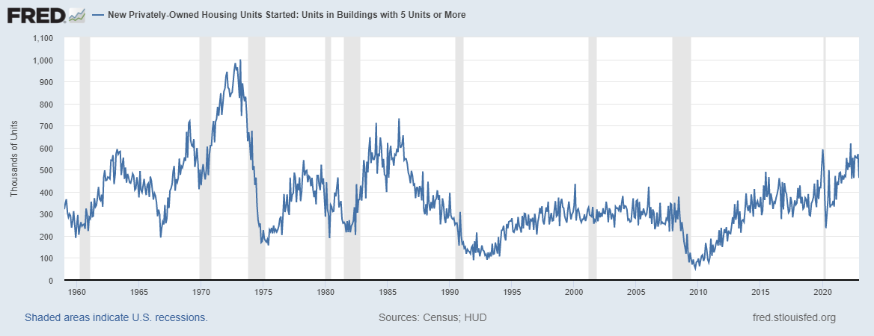

Slide 5
The Impact on Communities
Many businesses reporting an inability to hire and/or keep employees
Young professionals are delaying buying a home and establishing families
Less expendable income for individuals and families to spend

Slide 6
Biden School Housing Team’s Work
Housing Webinar Series
Healthier Housing Report for Habitat for Humanity Delaware Chapters
Coordinating and collaborating with
Housing professionals
State officials
Local officials
Economic development & business community

Slide 7
How Can Your Chamber Help?
Identify how businesses are being impacted
Share stories and information on how the local economy is being impacted
Advocate for solutions

Slide 8
Potential Solutions
Allow more multifamily housing development
Allow accessory dwelling units (sometimes referred to as “granny flats”)
Advocate for more State and County funding for affordable housing
Advocate for ALL large developments to include workforce housing units (typically 10-20%)
Join the YIMBY movement and stop fighting new development that is non-single family

Slide 9
Potential Solutions
Form a 501c3 Housing Partnership in order to directly address the crisis
Join with local housing advocates to collectively advocate and develop new workforce and affordable housing options in the Rehoboth area
Successful Examples
Housing Forward Virginia (Statewide in Virginia)
Lancaster Housing Opportunity Partnership (Lancaster, PA)
Vail Housing Partnership (Vail, CO)

Slide 10
Biden School Housing Policy Team
Stephen Metraux, Director Center for Community Research and Service metraux@udel.edu
Roger Hesketh, Community Revitalization Center for Community Research and Service rogergh@udel.edu
Mimi Rayl, Housing Initiatives Coordinator Center for Community Research and Service mimirayl@udel.edu
Jerome Lewis, Director Institute for Public Administration jlewis@udel.edu
Julia O’Hanlon, Policy Scientist Institute for Public Administrations jusmith@udel.edu
Sean O’Neill, Policy Scientist Institute for Public Administration oneill@udel.edu
Notes:
Mimi- pick up where Steve and Jerome leave off on the team, introduce the rest of the gang, and a little bit more detail about today

